Slide 1
Project Management Articles
Author: Chalapko Egor

Slide 2
Definition and Important Concepts
Project Management is the art of managing all the aspects of a project from inception to closure using a scientific and structured methodology
Program Management is defined as a department that centralizes the management of projects.

Slide 3
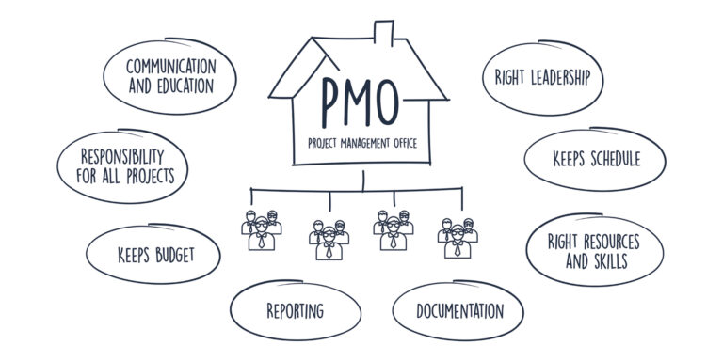
Definition and Important Concepts

Slide 4
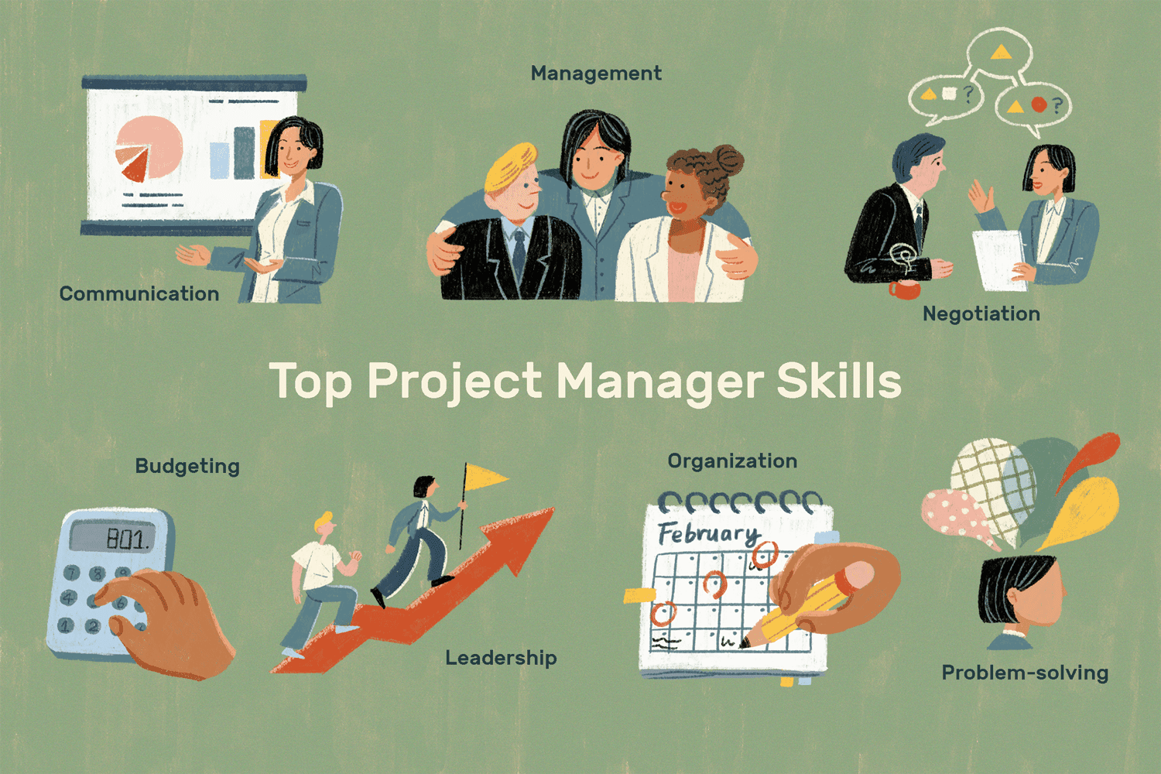
Definition and Important Concepts
The Project Manager’s role is to ensure that the overall objectives of the project are achieved with the participation of each individual member

Slide 5
What is Project Management ?
Project Characteristics
Timeline: A project has a definite timeline with measurable starting and end point.
Resources: A project has limited resource of capital and manpower.
Tools: Special type of tools and techniques are used for project management (Gantt Charts, etc.)
Team: Project management requires diverse team stretching across departments and functions.

Slide 6
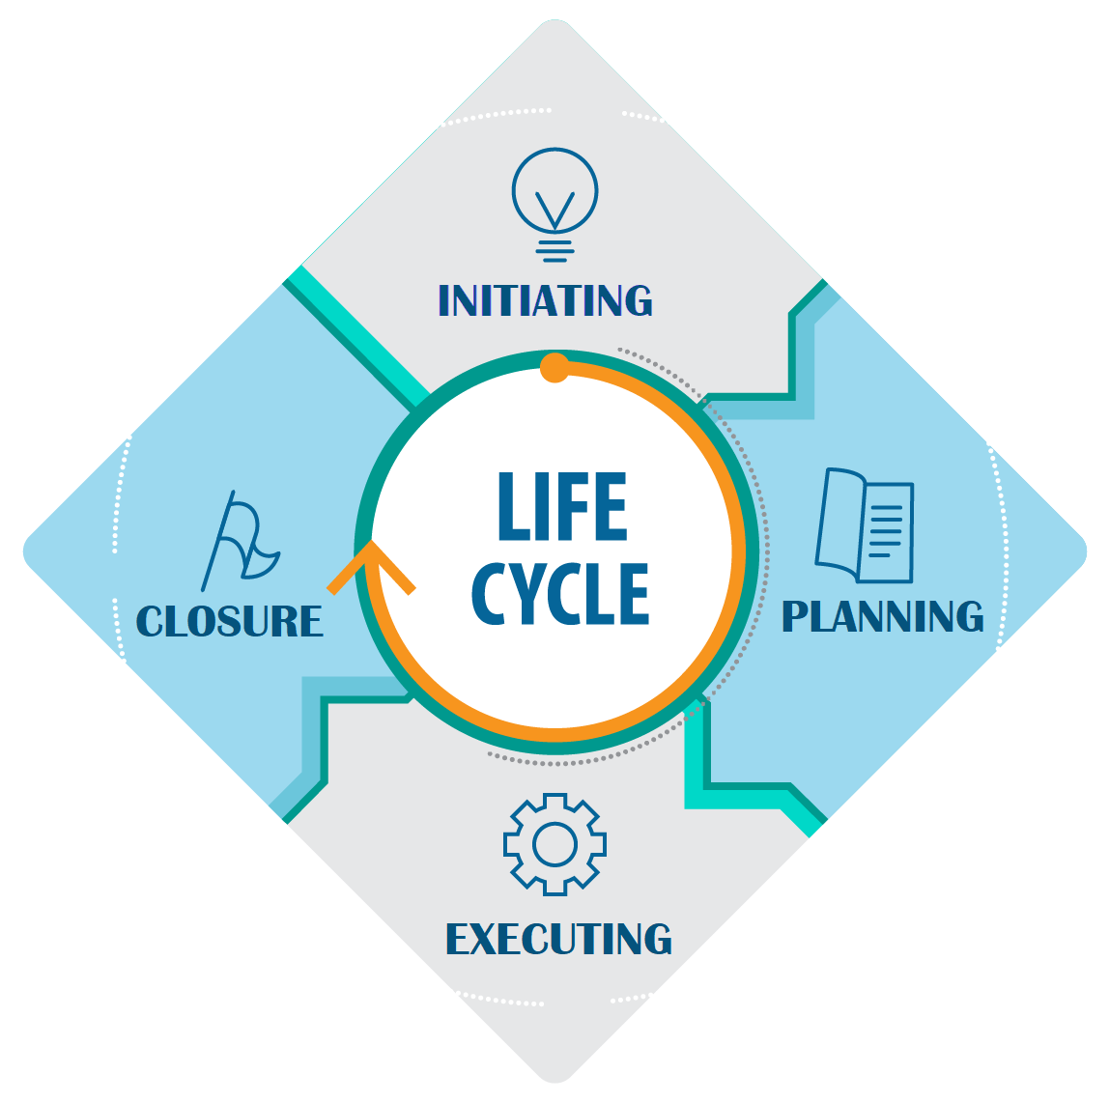
What is Project Management ?

Slide 7
What is Project Management ?
Project Management Activities
Planning: Planning activities include defining project objective, resource planning, etc.
Scheduling: Scheduling activities include developing detailed milestones and guidelines for the project. These activities are performed typically before actual initiation of the project.
Controlling: Controlling activities include developing budget and finance control points, measuring of scheduled tasks are performed.

Slide 8
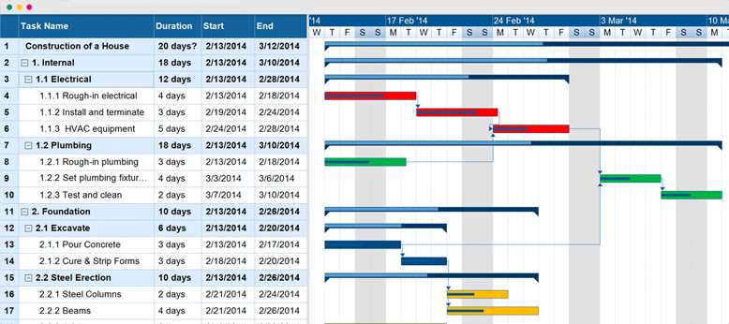
What is Project Management ?

Slide 9
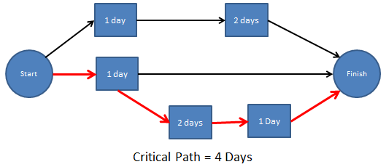
What is Project Management ?

Slide 10
What is Project Management ?
Project management includes: identifying requirements, establishing clear and achievable objectives, balancing the competing demands from the different stakeholders and ensuring that a commonality of purpose is achieved.

Slide 11
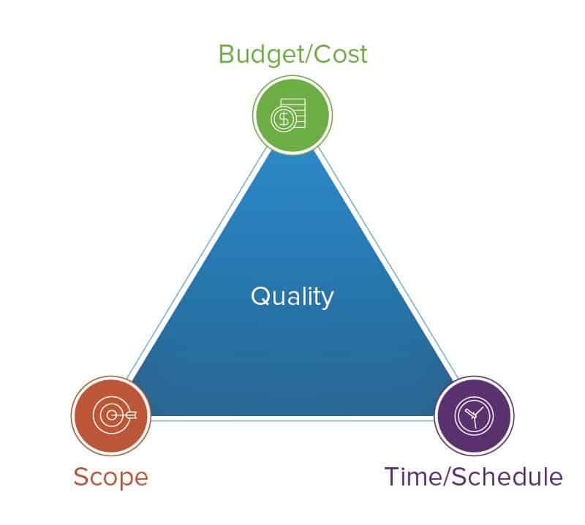
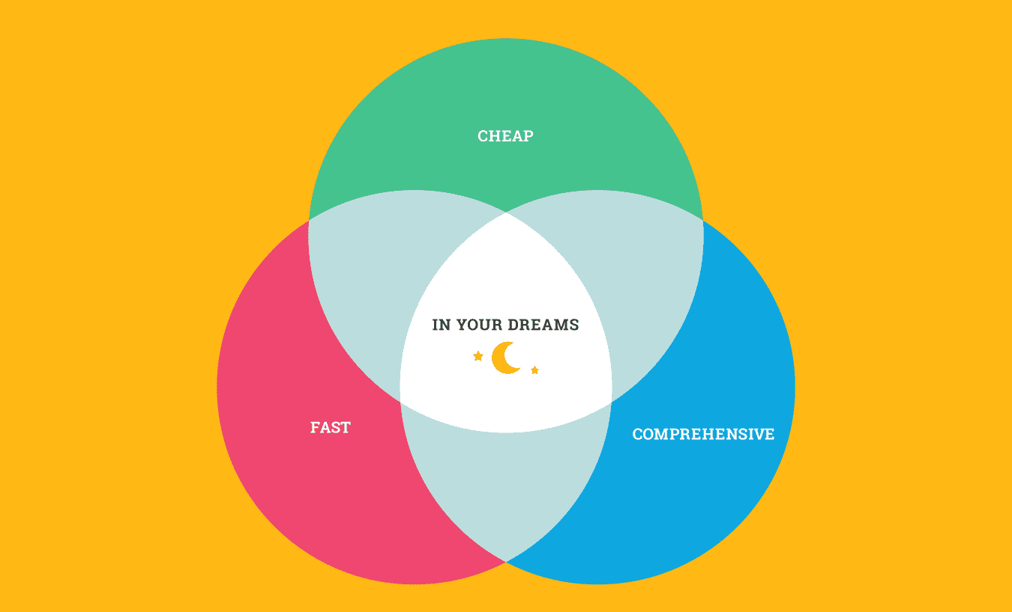
What is Project Management ?

